Slide 1
GRADE 7 ACCELERATED · UNIT 3 · LESSON 5
Applying Exponent Laws
MA.8.NSO.1.3
I can rewrite a rational base with a negative exponent using a positive exponent, and apply several laws to generate an equivalent expression.
Grade 7 Accelerated · Unit 3 · Lesson 5 — Applying Exponent Laws
1

Slide 2

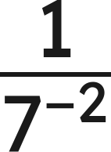


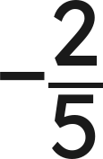
Warm-Up
1. Find the value:
2. Rewrite with a positive exponent:
3. Which is larger,
or
?
4. Write the reciprocal of
Grade 7 Accelerated · Unit 3 · Lesson 5 — Applying Exponent Laws
2

Slide 3



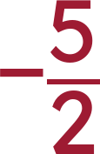
Warm-Up
1. Find the value:
2. Rewrite with a positive exponent:
3. Which is larger,
or
?
(81 > 64)
4. Write the reciprocal of
Grade 7 Accelerated · Unit 3 · Lesson 5 — Applying Exponent Laws
3

Slide 4
Notes
I. The pattern with a fraction base
Expression | Expanded | Value
(2/5)² | 2/5 · 2/5 | 4/25
(2/5)¹ | 2/5 | 2/5
(2/5)⁰ | 1 | 1
(2/5)⁻¹ | 5/2 | 5/2
(2/5)⁻² | 5/2 · 5/2 | 25/4
Grade 7 Accelerated · Unit 3 · Lesson 5 — Applying Exponent Laws
4

Slide 5
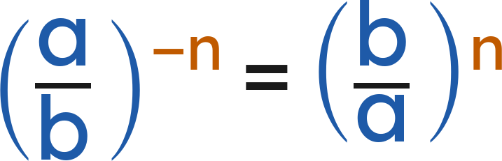
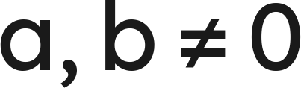
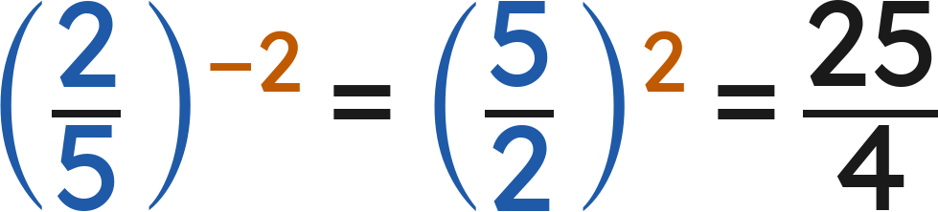
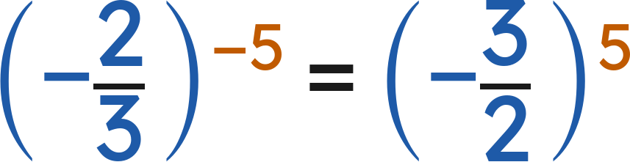
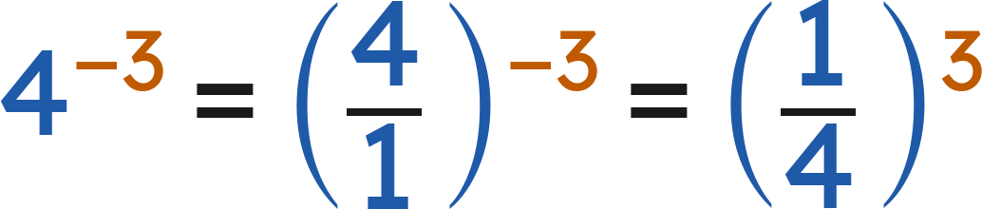
Notes
II. Flip the base, make the exponent positive
(
)
The sign stays with the fraction. Flip the numbers, not the sign.
A whole number is a fraction over 1:
Grade 7 Accelerated · Unit 3 · Lesson 5 — Applying Exponent Laws
5

Slide 6
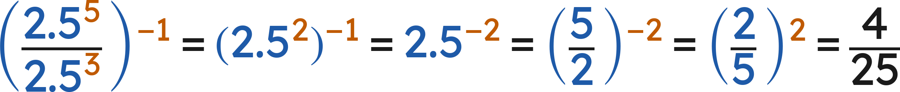
Notes
III. Several laws at once — the plan is still yours
Any correct order of laws gives the same value. Finish with a positive exponent.
Grade 7 Accelerated · Unit 3 · Lesson 5 — Applying Exponent Laws
6

Slide 7
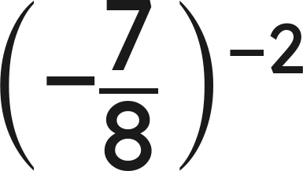
Example 1
Rewrite with a positive exponent, then find the value.
Grade 7 Accelerated · Unit 3 · Lesson 5 — Applying Exponent Laws
7

Slide 8
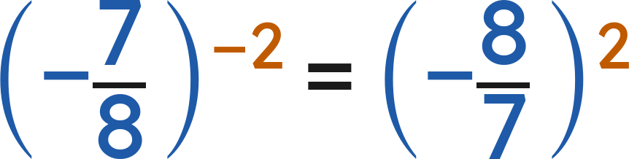
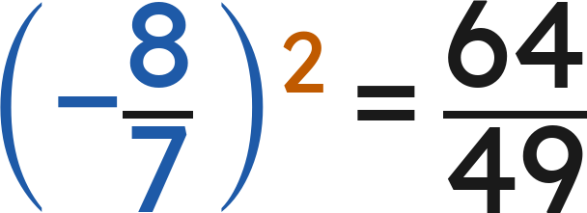
Example 1
Answer: 64/49
Grade 7 Accelerated · Unit 3 · Lesson 5 — Applying Exponent Laws
8

Slide 9
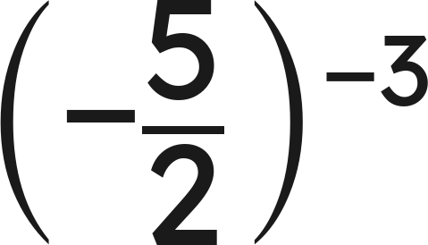
Your Turn
Rewrite with a positive exponent, then find the value.
Grade 7 Accelerated · Unit 3 · Lesson 5 — Applying Exponent Laws
9

Slide 10
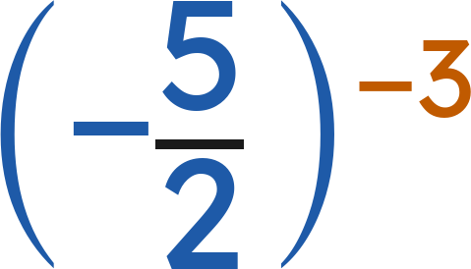
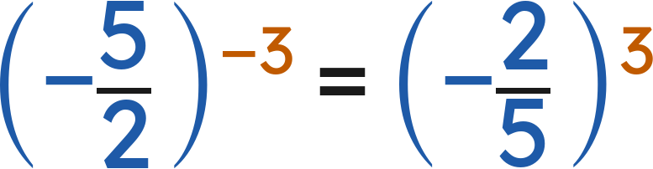
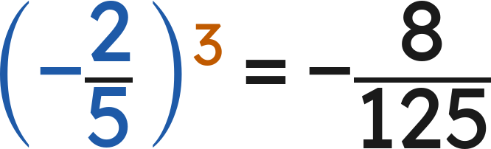
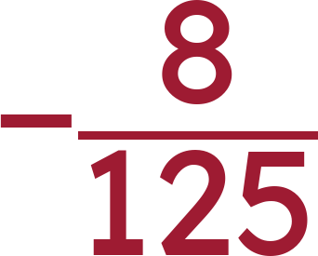
Your Turn
Rewrite with a positive exponent, then find the value.
Flip the fraction:
Answer:
Grade 7 Accelerated · Unit 3 · Lesson 5 — Applying Exponent Laws
10

Slide 11
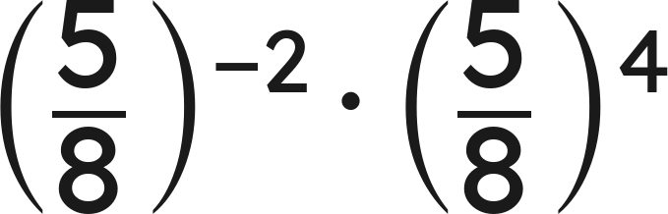
Example 2
Write an equivalent expression with one base and a positive exponent.
Grade 7 Accelerated · Unit 3 · Lesson 5 — Applying Exponent Laws
11

Slide 12
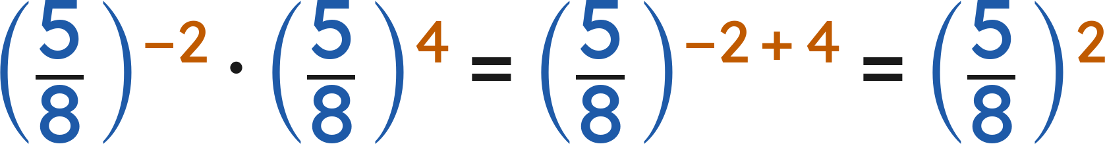
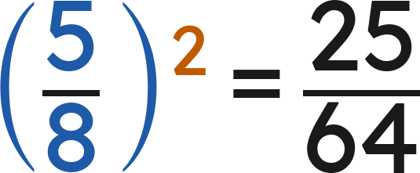
Example 2
Answer: (5/8)² = 25/64
Grade 7 Accelerated · Unit 3 · Lesson 5 — Applying Exponent Laws
12

Slide 13
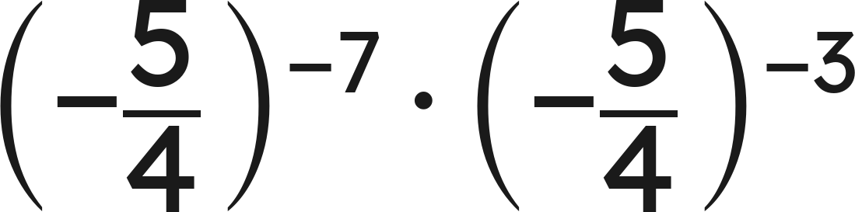
Your Turn
Write an equivalent expression with one base and a positive exponent.
Grade 7 Accelerated · Unit 3 · Lesson 5 — Applying Exponent Laws
13

Slide 14
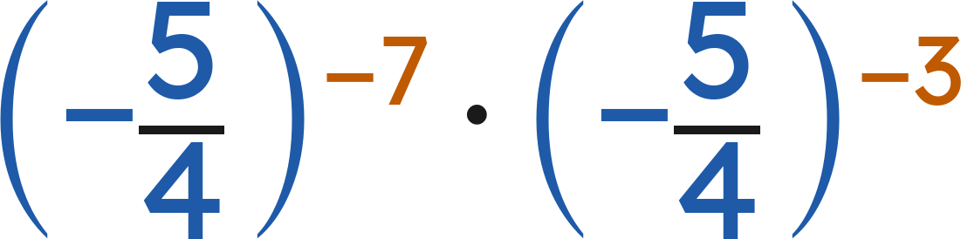
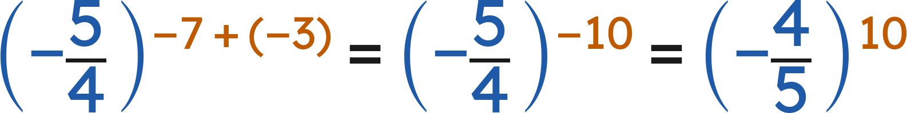
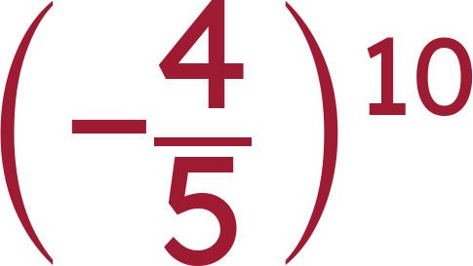
Your Turn
Write an equivalent expression with one base and a positive exponent.
Add the exponents, then flip the fraction:
Answer:
Grade 7 Accelerated · Unit 3 · Lesson 5 — Applying Exponent Laws
14

Slide 15

Whiteboards · Question 1 of 9
A copier is set to shrink a page to
of its size.
A page 6 inches wide is copied 4 times in a row, each copy from the last.
What fraction of the original page's size is the last copy?
Answer it.
Grade 7 Accelerated · Unit 3 · Lesson 5 — Applying Exponent Laws
15

Slide 16

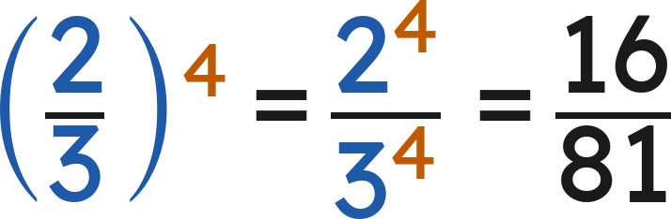

Whiteboards · Question 1 of 9
A copier is set to shrink a page to
of its size.
A page 6 inches wide is copied 4 times in a row, each copy from the last.
What fraction of the original page's size is the last copy?
Four copies:
Answer:
Grade 7 Accelerated · Unit 3 · Lesson 5 — Applying Exponent Laws
16

Slide 17
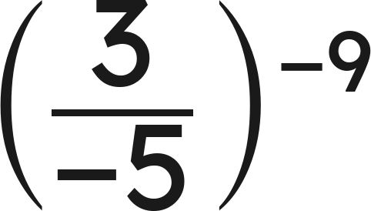
Whiteboards · Question 2 of 9
Answer it.
Grade 7 Accelerated · Unit 3 · Lesson 5 — Applying Exponent Laws
17

Slide 18
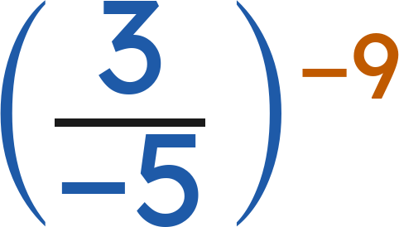
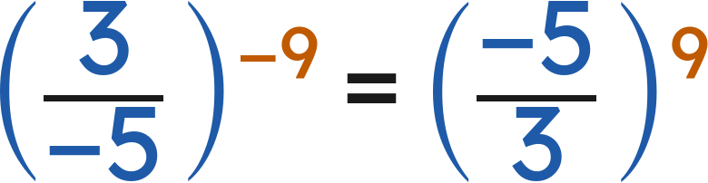
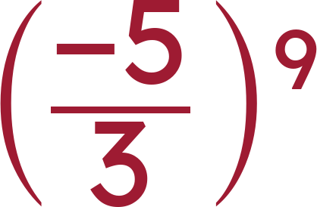
Whiteboards · Question 2 of 9
Flip the fraction:
Answer:
Grade 7 Accelerated · Unit 3 · Lesson 5 — Applying Exponent Laws
18

Slide 19
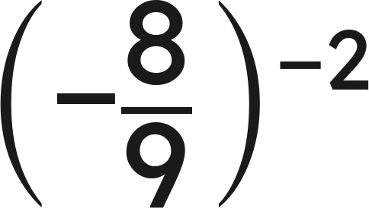
Whiteboards · Question 3 of 9
Answer it.
Grade 7 Accelerated · Unit 3 · Lesson 5 — Applying Exponent Laws
19

Slide 20
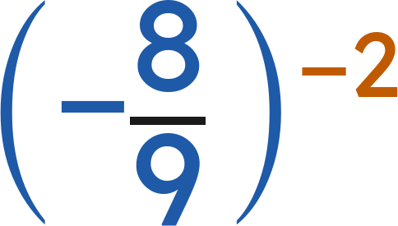
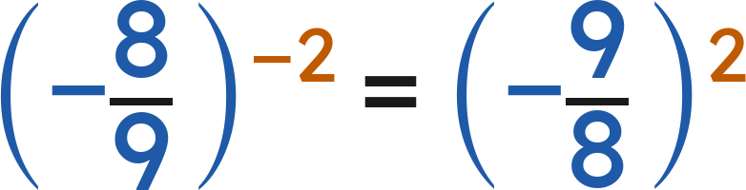
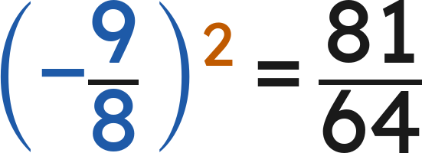
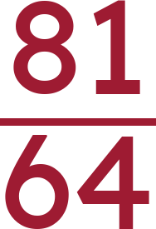
Whiteboards · Question 3 of 9
Flip the fraction:
Answer:
Grade 7 Accelerated · Unit 3 · Lesson 5 — Applying Exponent Laws
20

Slide 21
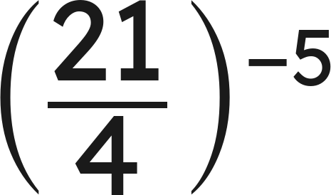
Whiteboards · Question 4 of 9
Answer it.
Grade 7 Accelerated · Unit 3 · Lesson 5 — Applying Exponent Laws
21

Slide 22
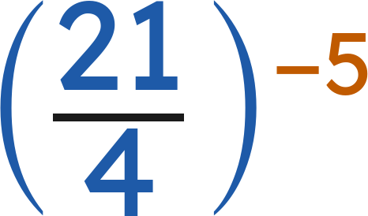
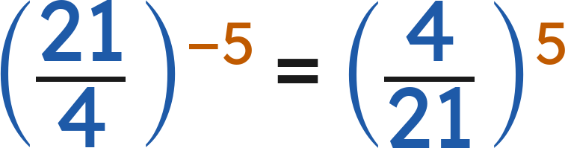
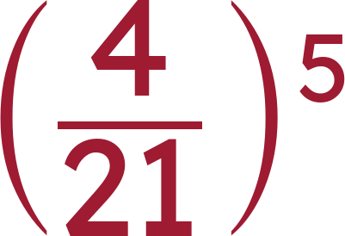
Whiteboards · Question 4 of 9
Flip the fraction:
Answer:
Grade 7 Accelerated · Unit 3 · Lesson 5 — Applying Exponent Laws
22

Slide 23
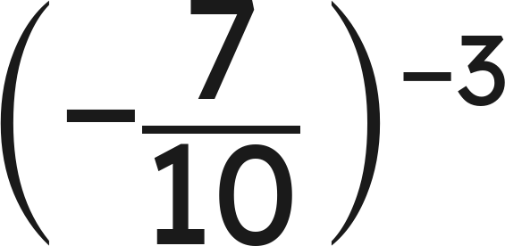
Whiteboards · Question 5 of 9
Which expression is equivalent?
A. (7/10)³
B. (−10/7)³
C. (−7/10)³
D. (10/7)³
Answer it.
Grade 7 Accelerated · Unit 3 · Lesson 5 — Applying Exponent Laws
23

Slide 24
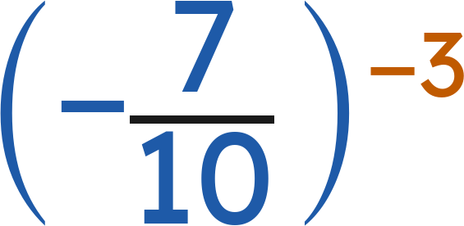
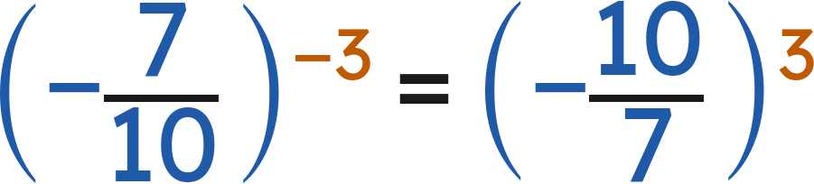
Whiteboards · Question 5 of 9
Which expression is equivalent?
Flip the fraction. The sign stays:
Answer: B — (−10/7)³
Grade 7 Accelerated · Unit 3 · Lesson 5 — Applying Exponent Laws
24

Slide 25
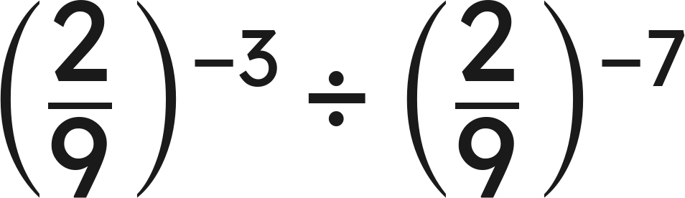
Whiteboards · Question 6 of 9
Which expression is equivalent?
A. (9/2)⁴
B. (2/9)⁻¹⁰
C. (2/9)⁴
D. (2/9)²¹
Answer it.
Grade 7 Accelerated · Unit 3 · Lesson 5 — Applying Exponent Laws
25

Slide 26
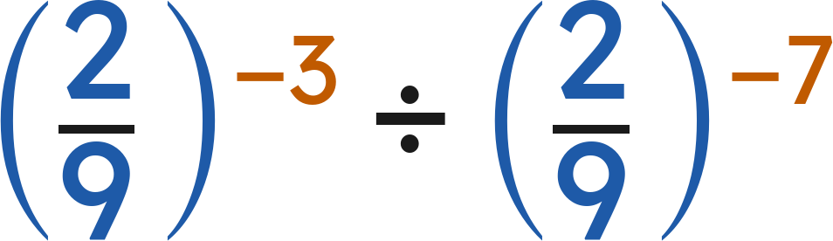
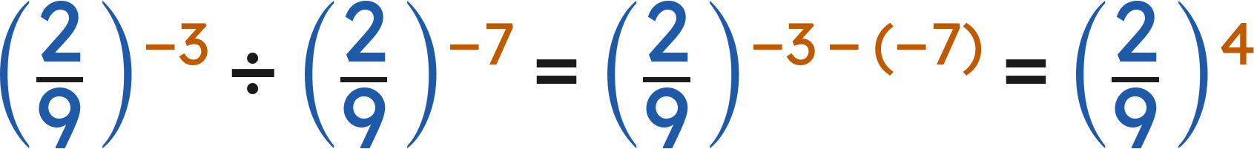
Whiteboards · Question 6 of 9
Which expression is equivalent?
Answer: C — (2/9)⁴
Grade 7 Accelerated · Unit 3 · Lesson 5 — Applying Exponent Laws
26

Slide 27
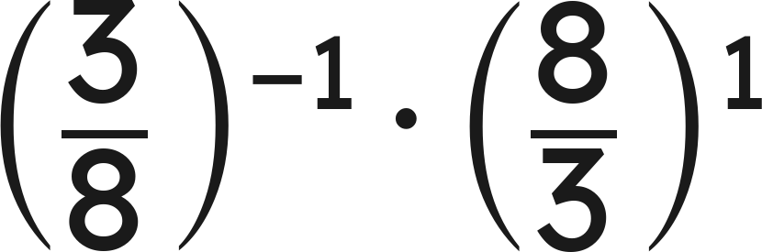
Whiteboards · Question 7 of 9
Answer it.
Grade 7 Accelerated · Unit 3 · Lesson 5 — Applying Exponent Laws
27

Slide 28
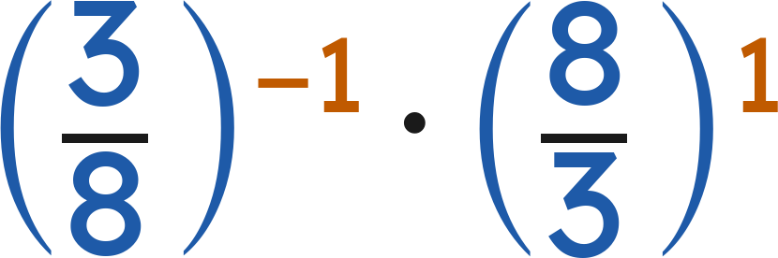
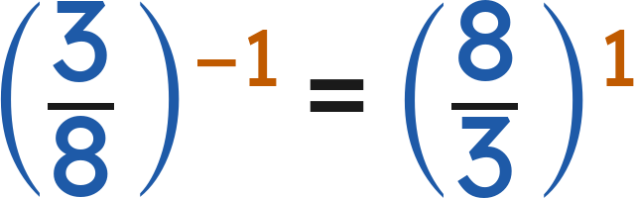
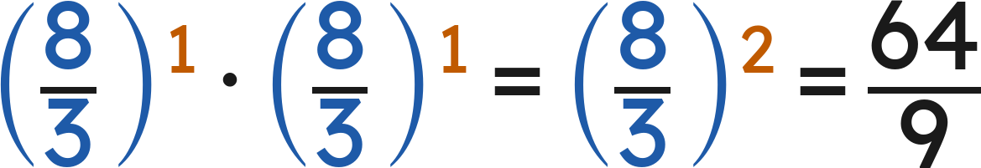
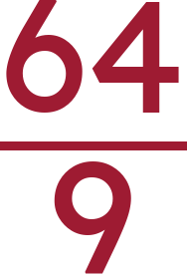
Whiteboards · Question 7 of 9
Answer:
Grade 7 Accelerated · Unit 3 · Lesson 5 — Applying Exponent Laws
28

Slide 29
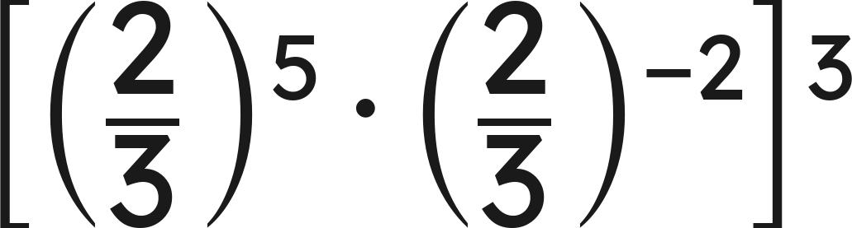
Whiteboards · Question 8 of 9
Answer it.
Grade 7 Accelerated · Unit 3 · Lesson 5 — Applying Exponent Laws
29

Slide 30




Whiteboards · Question 8 of 9
Inside:
Answer:
Grade 7 Accelerated · Unit 3 · Lesson 5 — Applying Exponent Laws
30

Slide 31


Whiteboards · Question 9 of 9
Marco says
can be rewritten as
because 'two negatives make a positive.' Is he right?
Write your answer in sentences.
Grade 7 Accelerated · Unit 3 · Lesson 5 — Applying Exponent Laws
31

Slide 32



Whiteboards · Question 9 of 9
Marco says
can be rewritten as
because 'two negatives make a positive.' Is he right?
The negative exponent flips the fraction. The sign stays.
Answer: No — (−4/11)⁻⁷ = (−11/4)⁷
Grade 7 Accelerated · Unit 3 · Lesson 5 — Applying Exponent Laws
32

Slide 33







Independent Set
1.
Rewrite with a positive exponent.
2.
Find the value.
3.
Rewrite with a positive exponent.
4.
Find the value.
5.
Find the value.
6.
Find the value of
.
Grade 7 Accelerated · Unit 3 · Lesson 5 — Applying Exponent Laws
33

Slide 34
IXL
1.
Open IXL and start today's skills.
2.
Work on paper where the question needs work. The answer box does not show it.
3.
Every skill listed is required, to a SmartScore of 67. Due at the start of the next class.
Today's skills — all required
Identify equivalent expressions involving exponents I — VLM
Grade 7 Accelerated · Unit 3 · Lesson 5 — Applying Exponent Laws
34

